Slide 1
What is Mathematics, really?
It’s not just about numbers!
But, the concepts can relate to numbers, symbols, visual patterns, or anything!
Mathematics is the study of any and all <absolutely certain truths> about
any and all perfectly well-defined concepts.
115/11/07
Notes:
Discrete Mathematics and its Applications
115/11/07
(c)2001-2002, Michael P. Frank
As you may have already concluded from the title of the textbook, this is a course about mathematics. But, it is a type of mathematics that may be unfamiliar to you. You may have concluded from your exposure to math so far that mathematics is primarily about numbers. But really, that’s not true at all. The essence of mathematics is just the study of formal systems in general. A formal system is any kind of entity that is defined perfectly precisely, so that there can be no misunderstanding about what is meant. Once such a system has been set forth, and a set of rules for reasoning about it has been laid out, then, anything you can deduce about that system while following those rules is an absolute certainty, within the context of that system and those rules. Number systems aren’t the only kinds of system that we can reason about, just one kind that is widely useful. For example, we also reason about geometrical figures in geometry, surfaces and other spaces in topology, images in image algebra, and so forth.
Any time you precisely define what you are talking about, set forth a set of definite axioms and rules for some system, then it is by definition a mathematical system, and any time you discover some unarguable consequence of those rules, you are doing mathematics.
In this course, we’ll encounter many kinds of perfectly precisely defined (and thus, by definition, mathematical) concepts other than just numbers. You will learn something of the richness and variety of mathematics. And, we will also teach you the language and methods of logic, which allow us to describe mathematical proofs, which are linguistic presentations that establish conclusively the absolute truth of certain statements (theorems) about these concepts.
In a sense, it’s easy to create your own new branch of mathematics, never before discovered: just write down a set of axioms and inference rules, make sure their meanings are perfectly clear, and then work out their consequences. Whether anyone else finds your new area of mathematics particularly interesting is another matter. The areas of math that have been thoroughly explored by large numbers of people are generally ones that have a large number of applications in helping to understand some other subject, whether it be another area of mathematics, or physics, or economics, biology, sociology, or whatever other field.
See http://mathworld.wolfram.com/ for a survey of some other areas of mathematics, to show you just how much there is to mathematics, besides just numbers!

Slide 2
So, what’s this class about?
What are “discrete structures” anyway?
“Discrete” - Composed of distinct, separable parts. (Opposite of continuous.)
discrete:continuous :: digital:analog
“Structures” - objects built up from simpler objects according to a definite pattern.
“Discrete Mathematics” - The study of discrete, mathematical objects and structures.
115/11/07
Notes:
Discrete Mathematics and its Applications
115/11/07
(c)2001-2002, Michael P. Frank
The title of this course (at UF) is “Applications of Discrete Structures.” Actually that title is misleading. Although discrete math has many applications, which we’ll survey in a moment, this class is not really about applications so much as it is about basic mathematical skills and concepts. My guess is that the only reason we call the course “Applications of Discrete Structures” rather than just “Discrete Mathematics” so that the people over in the Math department don’t get upset that we’re teaching our own basic math course over here, rather than leaving it to them.
Anyway, that issue aside, you may be wondering, what is a “discrete structure” anyway? Well, by “discrete” we don’t mean something that’s kept secret – that’s “discreet” with a double-e, a homonym, a completely different English word with a completely different meaning. No, our word “discrete” just means something made of distinct, atomic parts, as opposed to something that is smooth and continuous, like the curves you studied in calculus. Later in the course we’ll learn how to formalize this distinction more precisely using the concepts of countable versus uncountable sets. But for now, this intuitive concept suffices.
By “structures” we just mean objects that can be built up from simpler objects according to some definite, regular pattern, as opposed to unstructured, amorphous blobs. In this course, we’ll see how various types of discrete mathematical objects can be built up from other discrete objects in a well-defined way.
The field of discrete mathematics can be summarized as the study of discrete, mathematical (that is, well-defined, conceptual) objects, both primitive objects and more complex structures.

Slide 3
Discrete Structures We’ll Study
Propositions
Predicates
(Discrete) Functions
Orders of Growth
Algorithms
Integers
Boolean Algebra
Finite-State Machine
Proofs
Summations
Permutations
Combinations
Relations
Graphs
Trees
115/11/07
Notes:
Discrete Mathematics and its Applications
115/11/07
(c)2001-2002, Michael P. Frank
Here are just a few of the kinds of discrete structures and related concepts that we’ll be studying this semester.

Slide 4
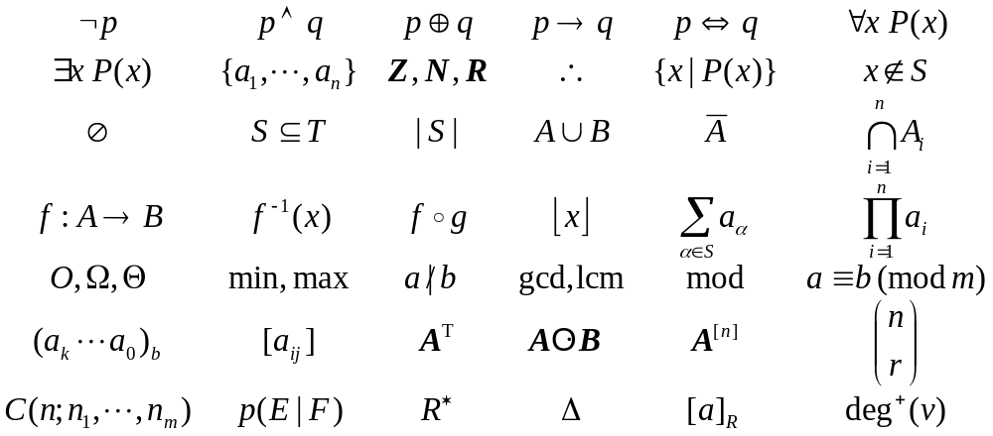
Some Notations We’ll Learn
115/11/07
(c)2001-2003, Michael P. Frank

Slide 5
Why Study Discrete Math?
The basis of all of digital information processing: Discrete manipulations of discrete structures represented in memory.
It’s the basic language and conceptual foundation of all of computer science.
Discrete concepts are also widely used throughout math, science, engineering, economics, biology, etc., …
A generally useful tool for rational thought!
115/11/07

Slide 6
Uses for Discrete Math in Computer Science
Advanced algorithms & data structures
Programming language compilers & interpreters.
Computer networks
Operating systems
Computer architecture
Database management systems
Cryptography
Error correction codes
Graphics & animation algorithms, game engines
Just about everything!
115/11/07

Slide 7
Course Objectives
Upon completion of this course, the student should be able to:
  Check the validity of simple logical arguments.
  Check the correctness of simple algorithms.
  Creatively construct simple valid logical arguments.
  Creatively construct simple correct algorithms.
  Describe the definitions and properties of a variety of specific types discrete structures.
  Correctly read, write and analyze various types of structures using standard notations.
Think!
115/11/07
Notes:
Discrete Mathematics and its Applications
115/11/07
(c)2001-2002, Michael P. Frank
This summarizes the course objectives. The syllabus goes into this in more detail. The most important objective (in my opinion) is that after taking this course (if not before), the student should be capable of creative, correct logical thought. Working with specific kinds of discrete structures is a good way to practice this skill, and the knowledge gained is useful due to the widespread use of these structures.

Slide 8
Discrete vs. Continuous Mathematics
  Continuous Mathematics
  It considers objects that vary continuously;
  Example: analog wristwatch (separate hour, minute, and second hands).
  From an analog watch perspective, between 1 :25 p.m. and 1 :26 p.m.
  there are infinitely many possible different times as the second hand moves
  around the watch face.
  Real-number system --- core of continuous mathematics;
  Continuous mathematics --- models and tools for analyzing real-world
  phenomena that change smoothly over time. (Differential equations etc.)

Slide 9
Discrete vs. Continuous Mathematics
  Discrete Mathematics
  It considers objects that vary in a discrete way.
  Example: digital wristwatch.
  On a digital watch, there are only finitely many possible different times
  between 1 :25 P.M. and 1:27 P.M. A digital watch does not show split
  seconds: - no time between 1 :25:03 and 1 :25:04. The watch moves from one
  time to the next.
  Integers --- core of discrete mathematics
  Discrete mathematics --- models and tools for analyzing real-world
  phenomena that change discretely over time and therefore ideal for studying
  computer science – computers are digital! (numbers as finite bit strings; data structures, all discrete! Historical aside: earliest computers were analogue.)

Slide 10
Foundations of Logic
Mathematical Logic is a tool for working with elaborate compound statements. It includes:
A formal language for expressing them.
A concise notation for writing them.
A methodology for objectively reasoning about their truth or falsity.
It is the foundation for expressing formal proofs in all branches of mathematics.

Slide 11
Foundations of Logic: Overview
Propositional logic (§1.1-1.2):
  Basic definitions. (§1.1)
  Equivalence rules & derivations. (§1.2)
Predicate logic (§1.3-1.4)
  Predicates.
  Quantified predicate expressions.
  Equivalences & derivations.

Slide 12
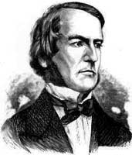
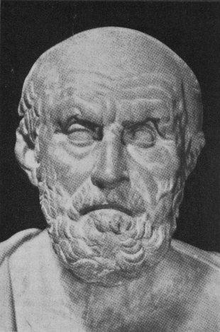
Propositional Logic (§1.1)
Topic #1 – Propositional Logic
Propositional Logic is the logic of compound statements built from simpler statements
using so-called Boolean connectives.
Some applications in computer science:
Design of digital electronic circuits.
Expressing conditions in programs.
Queries to databases & search engines.
George Boole
(1815-1864)
Chrysippus of Soli
(ca. 281 B.C. – 205 B.C.)
Notes:
We normally attribute propositional logic to George Boole, who first formalized it. Actually the particular formal notation we will present is not precisely Boole’s; he originally spoke of logic in terms of sets, not propositions, and he also used Boolean algebra notation such as AB, A+B, rather than the A /\ B, A \/ B notation we will use. But, he was the first to mathematically formalize these kinds of concepts in preserved writings. Boole’s formalization of logic was developed further by the philosopher Frege.
However, even though logic was not formalized as such until the 1800’s, the basic ideas of it go all the way back to the ancient Greeks. Aristotle (ca. 384-322 B.C.) developed a detailed system of logic (though one that was not quite as convenient and powerful as the modern one), and Chrysippus of Soli (ca. 281-205 B.C.) introduced a logic centered around logic AND, inclusive and exclusive OR, NOT, and implication, similarly to Boole’s. Chrysippus’ logic apparently included all of the key rules that Boole’s logic had. However, his original works were unfortunately lost; we only have fragments quoted by other authors.

Slide 13
Definition of a Proposition
Topic #1 – Propositional Logic
Definition: A proposition (denoted p, q, r, …) is simply:
a statement (i.e., a declarative sentence)
  with some definite meaning, (not vague or ambiguous)
having a truth value that’s either true (T) or false (F)
  it is never both, neither, or somewhere “in between!”
    However, you might not know the actual truth value,
    and, the value might depend on the situation or context.
Later, we will study probability theory, in which we assign degrees of certainty (“between” T and F) to propositions.
  But for now: think True/False only!

Slide 14
Examples of Propositions
Topic #1 – Propositional Logic
“It is raining.” (In a given situation.)
“Beijing is the capital of China.” • “1 + 2 = 3”
But, the following are NOT propositions:
“Who’s there?” (interrogative, question)
“La la la la la.” (meaningless interjection)
“Just do it!” (imperative, command)
“Yeah, I sorta dunno, whatever...” (vague)
“1 + 2” (expression with a non-true/false value)

Slide 15
Operators / Connectives
Topic #1.0 – Propositional Logic: Operators
An operator or connective combines one or more operand expressions into a larger expression. (E.g., “+” in numeric exprs.)
Unary operators take 1 operand (e.g., −3); binary operators take 2 operands (eg 3 × 4).
Propositional or Boolean operators operate on propositions (or their truth values) instead of on numbers.
Notes:
Later in the course, we will see that operators can themselves be defined in terms of functions. This slide doesn’t define them that way because we haven’t defined functions yet. But for your reference, when you come back to study this section after learning about functions, in general, an n-ary operator O on any set S (the domain of the operator) is a function O:S^n->S mapping n-tuples of members of S (the operands) to members of S. “S^n” here denotes S with n as a superscript, that is, the nth Cartesian power of S. All this will be defined later when we talk about set theory.
For Boolean operators, the set we are dealing with is B={True,False}.
A unary Boolean operator U is a function U:B->B, while a binary Boolean operator T is a function T:(B,B)->B.
Binary operators are conventionally written in between their operands, while unary operators are usually written in front of their operands. (One exception is the post-increment and post-decrement operators in C/C++/Java, which are written after their operands.)

Slide 16
Some Popular Boolean Operators
Topic #1.0 – Propositional Logic: Operators
Formal Name | Nickname | Arity | Symbol
Negation operator | NOT | Unary | ¬
Conjunction operator | AND | Binary | ∧
Disjunction operator | OR | Binary | ∨
Exclusive-OR operator | XOR | Binary | ⊕
Implication operator | IMPLIES | Binary | →
Biconditional operator | IFF | Binary | ↔

Slide 17
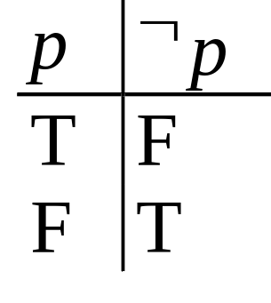
The Negation Operator
Topic #1.0 – Propositional Logic: Operators
The unary negation operator “¬” (NOT) transforms a prop. into its logical negation.
E.g. If p = “I have brown hair.”
then ¬p = “I do not have brown hair.”
The truth table for NOT:
T :≡ True; F :≡ False
“:≡” means “is defined as”
Operand
column
Result
column

Slide 18
The Conjunction Operator
Topic #1.0 – Propositional Logic: Operators
The binary conjunction operator “∧” (AND) combines two propositions to form their logical conjunction.
E.g. If p=“I will have salad for lunch.” and q=“I will have steak for dinner.”, then p∧q=“I will have salad for lunch and
I will have steak for dinner.”
∧ND
Remember: “∧” points up like an “A”, and it means “∧ND”

Slide 19
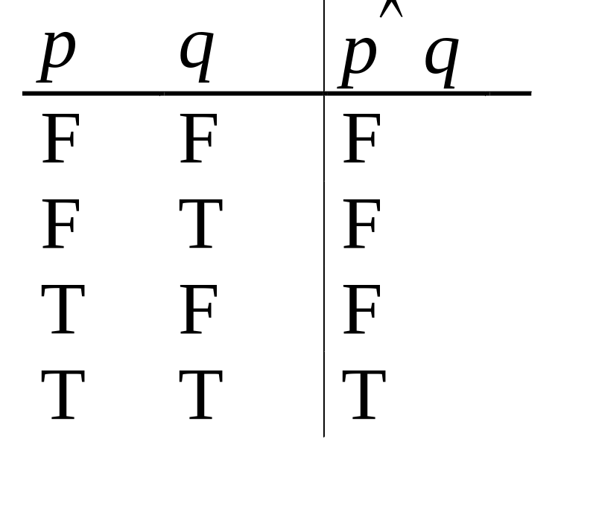
Conjunction Truth Table
Topic #1.0 – Propositional Logic: Operators
Operand columns
Note that a
conjunction
p₁ ∧ p₂ ∧ … ∧ p_{n}
of n propositions
will have 2^{n} rows
in its truth table.
Also: ¬ and ∧ operations together are suffi-cient to express any Boolean truth table!
Notes:
Note that AND is commutative and associative, which means that we can write a long conjunction (like in the first bullet on the left) without parenthesizing it. It also doesn’t matter what order the n propositions are in.
The fact that an n-operand operator has 2^n rows in its truth table is an easy consequence of the product rule of combinatorics. Here is a proof. Note that for the table to be complete, we must have 1 row for every possible assignment of truth values to the n operands. Thus, there is 1 row for every function f:V->B, where V is the set of operand columns {p,q,…} and B={T,F}. Here, |V|=n and |B|=2. The number of functions from a set of size n to a set of size m is m^n. This is because of the product rule, as we will see in a moment. In this case, m=2 so we get 2^n such functions. In terms of the product rule: There are 2 possible values for p. For each of these, there are 2 possible values for q, since the choice of q is independent of the choice of p. And so on. So there are 2x2x…(n repetitions)…x2 possible rows, thus 2^n. Of course, we haven’t defined the product rule, set cardinality, or functions yet, so don’t worry if the above argument doesn’t quite make sense to you yet.
In the second bullet, we would say, {NOT,AND} is a universal set of Boolean operators, but we haven’t even defined sets yet. If you already know what a set is, a universal set of operators over a given domain is a set of operators such that nested expressions involving those operators are sufficient to express any possible operator over that domain. In this case, the domain is B={T,F}. The proof that {NOT,AND} is universal is as follows: OR can be defined by p OR q = NOT(NOT(p) AND NOT(q)) (easily verified; this is one of DeMorgan’s Laws, which we will get to later). Now, armed with OR, AND, and NOT, we can show how to express any Boolean truth table, with any number of columns, as follows. Look for the cases where the last (result) column is T. For each such row in the truth table, include a corresponding term in a disjunctive expression for the whole truth table. The term should be a conjunction of terms, one for each input operand in that row. Each of these terms should be p if the entry in that position is “T”, and NOT(p) if the entry in that position is “F”. So, the entire expression basically says, “the value of the operator is T if and only if the pattern of truth values of the input operands exactly matches one of the rows in the truth table that ends in a ‘T’ result.” Thus, the expression directly encodes the content of the truth table.

Slide 20
The Disjunction Operator
Topic #1.0 – Propositional Logic: Operators
The binary disjunction operator “∨” (OR) combines two propositions to form their logical disjunction.
p=“My car has a bad engine.”
q=“My car has a bad carburetor.”
p∨q=“Either my car has a bad engine, or
my car has a bad carburetor.”
∨
After the downward-
pointing “axe” of “∨”
splits the wood, you
can take 1 piece OR the other, or both.
Meaning is like “and/or” in English.
Notes:
OR is also commutative and associative.
The animated picture on the right is just a memory device to help you remember that the disjunction operator is symbolized with a downward-pointing wedge, like the blade of an axe, because it “splits” a proposition into two parts, such that you can take either part (or both), if you are trying to decide how to make the whole proposition true.
Note that the meaning of disjunction is like the phrase “and/or” which is sometimes used in informal English. “The car has a bad engine and/or a bad carburetor.”

Slide 21
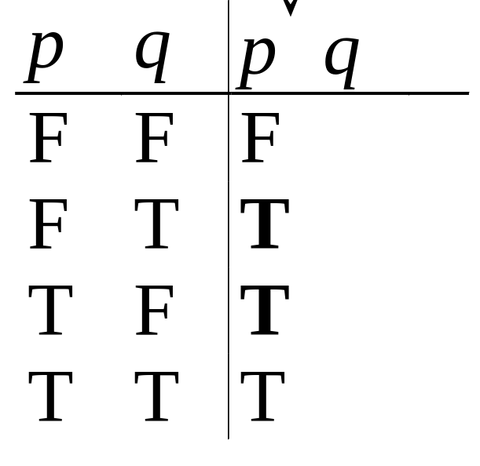
Disjunction Truth Table
Topic #1.0 – Propositional Logic: Operators
Note that p∨q means
that p is true, or q is
true, or both are true!
So, this operation is
also called inclusive or,
because it includes the
possibility that both p and q are true.
“¬” and “∨” together are also universal.
Note
difference
from AND

Slide 22
Nested Propositional Expressions
Topic #1.0 – Propositional Logic: Operators
Use parentheses to group sub-expressions:
“I just saw my old friend, and either he’s grown or I’ve shrunk.” = f ∧ (g ∨ s)
  (f ∧ g) ∨ s would mean something different
  f ∧ g ∨ s would be ambiguous
By convention, “¬” takes precedence over both “∧” and “∨”.
  ¬s ∧ f means (¬s) ∧ f , not ¬ (s ∧ f)
Notes:
As an exercise, drop the truth tables for f /\ (g \/ s) and (f /\ g) \/ s to see that they’re different, and thus the parentheses are necessary.
Precedence conventions such as the one in the second bullet help to reduce the number of parentheses needed in expressions. Note that negation, with its tight binding (high precedence), and with its position to the left of its operand, behaves similarly to a negative sign in arithmetic.
There is also a precedence convention that you see sometimes (for example, in the C programming language) that AND takes precedence over OR. However, this convention is not quite universally accepted, not all systems adopt it. Therefore, to be safe, you should always include parentheses whenever you are mixing ANDs and ORs in a single sequence of binary operators.

Slide 23
A Simple Exercise
Topic #1.0 – Propositional Logic: Operators
Let p=“It rained last night”,
q=“The sprinklers came on last night,”
r=“The lawn was wet this morning.”
Translate each of the following into English:
¬p =
r ∧ ¬p =
¬ r ∨ p ∨ q =
“It didn’t rain last night.”
“The lawn was wet this morning, and
it didn’t rain last night.”
“Either the lawn wasn’t wet this morning, or it rained last night, or the sprinklers came on last night.”
Notes:
For slides that have interactive exercises, it may be a good idea to stop the class for a minute to allow the students to discuss the problem with their neighbors, then call on someone to answer. This will help keep the students engaged in the lecture activity.

Slide 24
The Exclusive Or Operator
Topic #1.0 – Propositional Logic: Operators
The binary exclusive-or operator “⊕” (XOR) combines two propositions to form their logical “exclusive or” (exjunction?).
p = “I will earn an A in this course,”
q = “I will drop this course,”
p ⊕ q = “I will either earn an A in this course, or I will drop it (but not both!)”

Slide 25
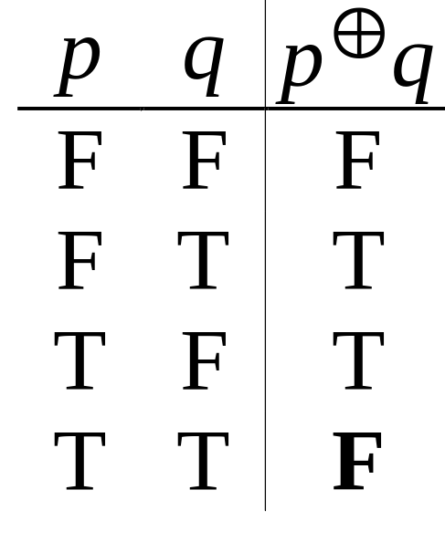
Exclusive-Or Truth Table
Topic #1.0 – Propositional Logic: Operators
Note that p⊕q means
that p is true, or q is
true, but not both!
This operation is
called exclusive or,
because it excludes the
possibility that both p and q are true.
“¬” and “⊕” together are not universal.
Note
difference
from OR.
Notes:
A good way to remember the symbol for XOR, a plus sign inside an O, is to think of XOR as adding the bit-values of its inputs (mod 2). E.g., 0+0=0, 1+0=0, 1+1=0 (mod 2). Thus XOR is basically an addition, and we put it inside an “O” to remind ourselves that it is a type of “Or”.
XOR together with unary operators do not form a universal set of operators over the Booleans. However, it turns out that they are a universal set for quantum logic! However we do not have time to cover quantum computing in this class, interesting though it is.

Slide 26
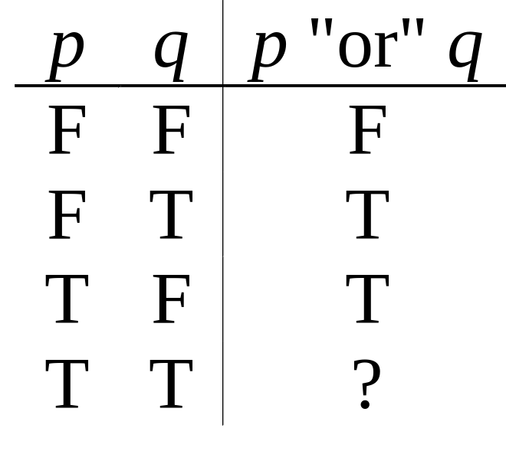
Natural Language is Ambiguous
Topic #1.0 – Propositional Logic: Operators
Note that English “or” can be ambiguous regarding the “both” case!
“Pat is a singer or
Pat is a writer.” -
“Pat is a man or
Pat is a woman.” -
Need context to disambiguate the meaning!
For this class, assume “or” means inclusive.
∨
⊕

Slide 27
The Implication Operator
Topic #1.0 – Propositional Logic: Operators
antecedent
consequent
The implication p → q states that p implies q.
I.e., If p is true, then q is true; but if p is not true, then q could be either true or false.
E.g., let p = “You study hard.”
q = “You will get a good grade.”
p → q = “If you study hard, then you will get a good grade.” (else, it could go either way)
Notes:
Note that the definition of “p implies q” says: “If p is true, then q is true, and if p is not true, then q is either true or false.” Well, saying that q is either true or false is not saying anything, since any proposition is, by the very definition of a proposition, either true or false. So, the last part of that sentence (covering the case where p is not true) is not really saying anything. So we may as well say the definition is, “If p is true, then q is true.”
Sometimes the antecedent is called the hypothesis and the consequent is called the conclusion.

Slide 28
Examples of Implications
Topic #1.0 – Propositional Logic: Operators
“If this lecture ends, then the sun will rise tomorrow.” True or False?
“If Tuesday is a day of the week, then I am a penguin.” True or False?
“If 1+1=6, then Bush is president.”
True or False?
“If the moon is made of green cheese, then I am richer than Bill Gates.” True or False?
Notes:
The first one is true because T->T is True. It doesn’t matter that my lecture ending is not the cause of the sun rising tomorrow.
The second one is false for me, because although Tuesday is a day of the week, I am most certainly NOT a penguin. (But, if a penguin were to say this statement, then it would be true for him.)
The third one is true, because 1+1 is not equal to 6. F->T is True.
The last one is true, because the moon is not made of green cheese. F->F is True.
In other words, anything that’s false implies anything at all. p->q if p is false. Why? If p is false, then if p is true, then p is both false and true at the same time, and so truth and falsity are the same thing. So if q is false then q is true.

Slide 29
Why does this seem wrong?
Consider a sentence like,
  “If I wear a red shirt tomorrow, then Osama bin Laden will be captured!”
In logic, we consider the sentence True so long as either I don’t wear a red shirt, or Osama is caught.
But, in normal English conversation, if I were to make this claim, you would think that I was lying.
  Why this discrepancy between logic & language?

Slide 30
Resolving the Discrepancy
In English, a sentence “if p then q” usually really implicitly means something like,
  “In all possible situations, if p then q.”
    That is, “For p to be true and q false is impossible.”
    Or, “I guarantee that no matter what, if p, then q.”
This can be expressed in predicate logic as:
  “For all situations s, if p is true in situation s, then q is also true in situation s”
  Formally, we could write: ∀s, P(s) → Q(s)
That sentence is logically False in our example, because for me to wear a red shirt and for Osama to stay free is a possible (even if not actual) situation.
  Natural language and logic then agree with each other.
Notes:
Later, we will learn an extension of propositional logic called predicate logic that allows us to express what we really mean by this english sentence.
Basically, “if .. then” sentences in English usually carry the connotation that they are always true, or true in all situations. Therefore, they really have a more complex structure than plain logically implication. When we get to the next section, on predicate logic, we will learn that we need to use an additional logical quantifier called FORALL to properly render such a sentence. So, if I make this claim “If I wear a red shirt the US will attack” you automatically assume that what I really mean is “For all possible courses of events that the world could follow tomorrow, if that course of events has me wearing a red shirt, then it will have the US attacking Iraq.” This sentence is False both intuitively and logically, because we surely agree that it is a possible course of events for tomorrow that I do wear a red shirt but the US does not attack Iraq.
In predicate logic, if we define the universe of discourse to be all possible versions of tomorrow t, and we define P(t) = “In tomorrow t, I wear a red shirt”, and Q(t) = “In tomorrow t, the U.S. attacks Iraq,” then the sentence would be rendered logically as “FORALL t, P(t) --> Q(t)”, which is False (agreeing with intuition) so long as there is a possible tomorrow t in which I do wear a red shirt and the US doesn’t attack.
If I don’t wear a red shirt, we don’t consider the sentence to have been verified, because it doesn’t prove what would have happened if I had worn the red shirt.
Even if I wear a red shirt, and the US does attack, we still don’t believe the sentence because it doesn’t prove that it wasn’t a possibility for the US not to attack.
It is important that you keep in mind that in pure logic, when we say “if p then q” or “p implies q” we explicitly do NOT mean that in ALL situations p implies q. For that we would say, FORALL s P(s)->Q(s). Rather, we just mean, “p is false or q is true”. So, the example says “I predict that tomorrow, either I will not be wearing a red shirt, or the US will be attacking Iraq.” I can make this prediction true (obviously) just by not wearing a red shirt. Since you believe that I can do this, you believe that sentence.

Slide 31
English Phrases Meaning p → q
Topic #1.0 – Propositional Logic: Operators
“p implies q”
“if p, then q”
“if p, q”
“when p, q”
“whenever p, q”
“q if p”
“q when p”
“q whenever p”
“p only if q”
“p is sufficient for q”
“q is necessary for p”
“q follows from p”
“q is implied by p”
We will see some equivalent logic expressions later.

Slide 32
Converse, Inverse, Contrapositive
Topic #1.0 – Propositional Logic: Operators
Some terminology, for an implication p → q:
Its converse is: q → p.
Its inverse is: ¬p → ¬q.
Its contrapositive: ¬q → ¬ p.
One of these three has the same meaning (same truth table) as p → q. Can you figure out which?
Contrapositive
Notes:
Also, note that the converse and inverse of p->q also have the same meaning as each other.

Slide 33
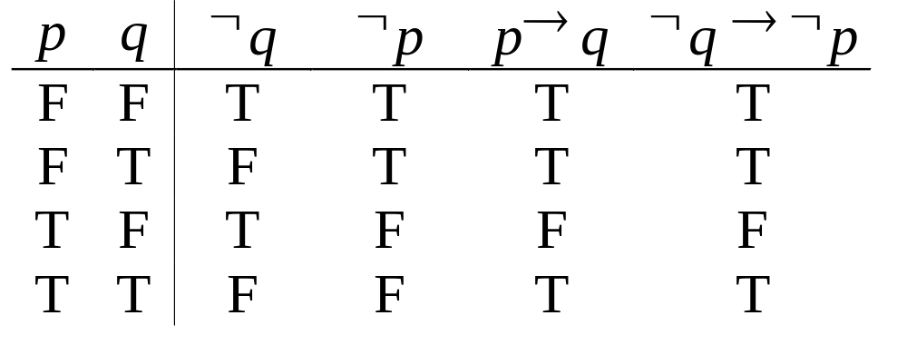
How do we know for sure?
Topic #1.0 – Propositional Logic: Operators
Proving the equivalence of p → q and its contrapositive using truth tables:

Slide 34

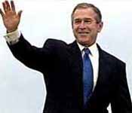
The biconditional operator
Topic #1.0 – Propositional Logic: Operators
The biconditional p ↔ q states that p is true if and only if (IFF) q is true.
p = “Bush wins the 2004 election.”
q = “Bush will be president for all of 2005.”
p ↔ q = “If, and only if, Bush wins the 2004 election, Bush will be president for all of 2005.”
I’m still
here!
2004
2005

Slide 35
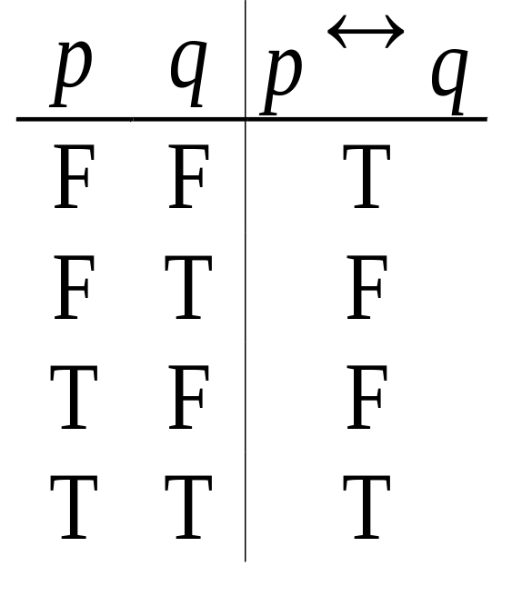
Biconditional Truth Table
Topic #1.0 – Propositional Logic: Operators
p ↔ q means that p and q
have the same truth value.
Note this truth table is the
exact opposite of ⊕’s!
  Thus, p ↔ q means ¬(p ⊕ q)
p ↔ q does not imply
that p and q are true, or cause each other.
Notes:
Also, p IFF q is equivalent to (p -> q) /\ (q -> p). (“/\” being the AND wedge)

Slide 36
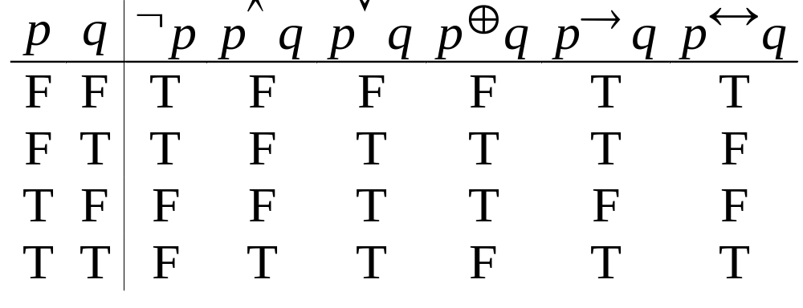
Boolean Operations Summary
Topic #1.0 – Propositional Logic: Operators
We have seen 1 unary operator (out of the 4 possible) and 5 binary operators (out of the 16 possible). Their truth tables are below.
Notes:
For fun, try writing down the truth tables for each of the 4 possible unary operators, and each of the 16 possible binary operators. For each one, try to come up with an English description of the operator that conveys its meaning. Also, figure out a way to define it in terms of other operators we already introduced.

Slide 37
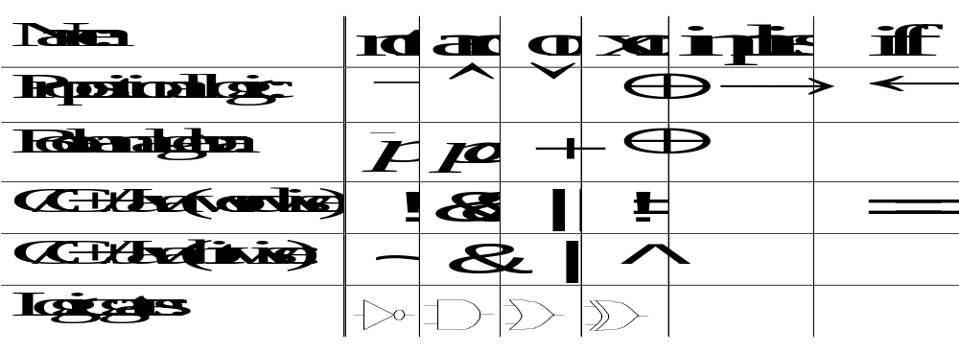
Some Alternative Notations
Topic #1.0 – Propositional Logic: Operators

Slide 38
Bit Strings
Topic #2 – Bits
A Bit string of length n is an ordered series or sequence of n≥0 bits.
  More on sequences in §3.2.
By convention, bit strings are written left to right: e.g. the first bit of “1001101010” is 1.
When a bit string represents a base-2 number, by convention the first bit is the most significant bit. Ex. 1101₂=8+4+1=13.
Notes:
We will talk about strings more generally later in the module on sequences.

Slide 39
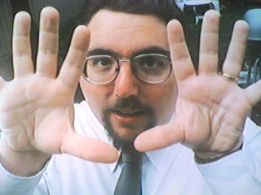
Counting in Binary
Topic #2 – Bits
Did you know that you can count
to 1,023 just using two hands?
  How? Count in binary!
    Each finger (up/down) represents 1 bit.
To increment: Flip the rightmost (low-order) bit.
  If it changes 1→0, then also flip the next bit to the left,
    If that bit changes 1→0, then flip the next one, etc.
0000000000, 0000000001, 0000000010, …
…, 1111111101, 1111111110, 1111111111
Notes:
This is just a fun exercise to practice with the binary number system. We’ll have more to say about binary (and base-n numbers in general) later in the course. If you demonstrate this technique, you should probably apologize to your audience when you get to 4.
The sequence in the last bullet is (in decimal): 0, 1, 2, … (skip a bunch) …, 1021, 1022, 1023. The next number, 1024 (or 1K) is 2^10. You would need 11 fingers to show it!

Slide 40
End of §1.1
You have learned about:
Propositions: What they are.
Propositional logic operators’
  Symbolic notations.
  English equivalents.
  Logical meaning.
  Truth tables.
Atomic vs. compound propositions.
Alternative notations.
Bits and bit-strings.
Next section: §1.2
  Propositional equivalences.
  How to prove them.

